Slide 1
Data Visualization

Slide 2
Table of Contents
Introduction to Matplotlib
Line Chart
Scatter Plot
Bar Chart
Histogram
Pie Chart

Slide 3
Matplotlib
Matplotlib is a cross-platform, data visualization and graphical plotting library for Python and its numerical extension NumPy. A Python matplotlib script is structured so that a few lines of code are all that is required in most instances to generate a visual data plot.
Matplotlib and NumPy: NumPy is a package for scientific computing. NumPy is a required dependency for matplotlib, which uses NumPy functions for numerical data and multi-dimensional arrays. Matplotlib and Pandas: Pandas is a library used by matplotlib mainly for data manipulation and analysis. Pandas provides an in-memory 2D data table object called a Dataframe. Unlike NumPy, pandas is not a required dependency of matplotlib.
Pandas and NumPy are often used together.

Slide 4
Line Chart
A line chart or line plot is a type of plot which displays information as a series of data points called markers connected by straight line segments. It is a basic type of chart common in many fields. We use line plot when we have a continuous data set. These are best suited for trend-based visualizations of data over a period of time.

Slide 5
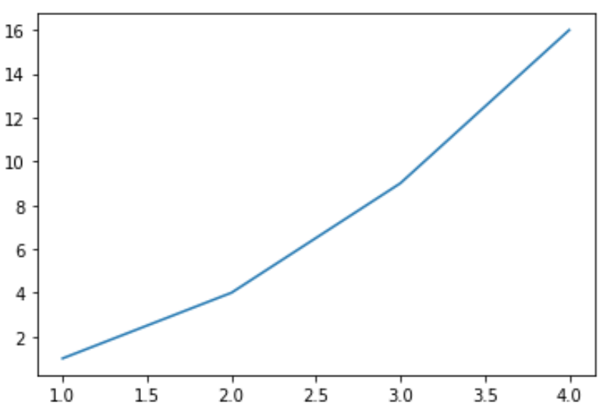
Line plot with Matplotlib
Matplotlib.pyplot is a collection of functions that make matplotlib. Generating visualizations with pyplot is very quick. See the following example:
Ex: import matplotlib.pyplot as plt plt.plot([ [1, 2, 3, 4], [1, 4, 9, 16])
plt.show()
>>>
First, we import matplotlib.pyplot here. Then we are using two list for x and y axis that we are passing as argument to the plot(). In default there is no marker and it looks like a line graph.

Slide 6
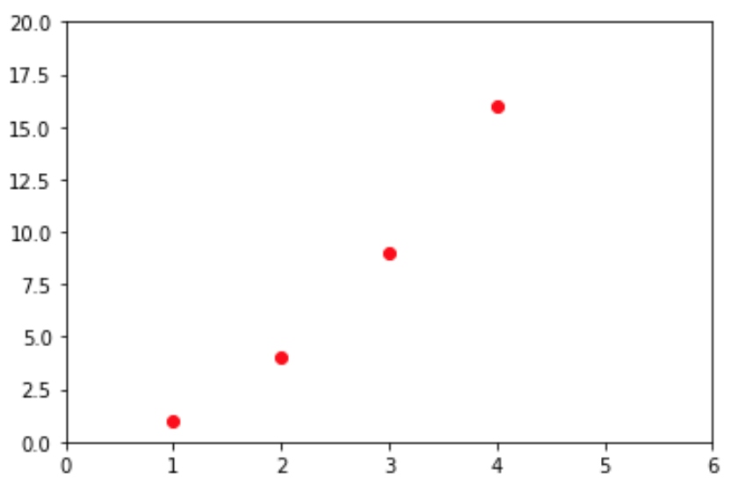
Formatting style
For every x, y pair of arguments, there is an optional third argument which is the format string that indicates the color and line type of the plot.
Ex: plt.plot([1, 2, 3, 4], [1, 4, 9, 16], 'ro')
plt.axis([0, 6, 0, 20])
plt.show()
>>>
'ro' defines round marker. Inside the axis() we are saying that x axis should bw within the range of 0 to 6 and y axis should be within the range of 0 to 20

Slide 7
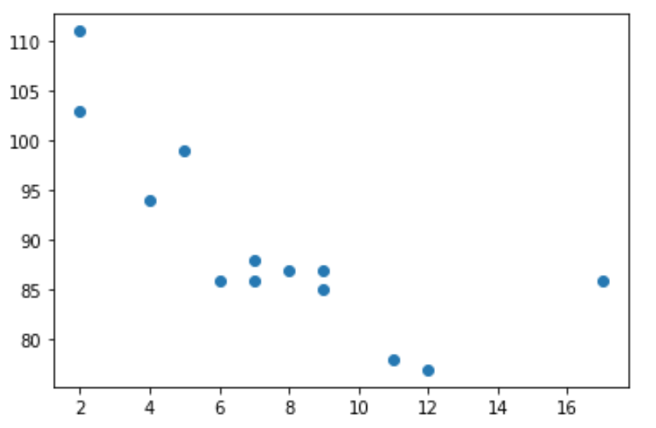
Scatter Plot
Scatter plot function plots one dot for each observation. It needs two arrays of the same length, one for the values of the x-axis, and one for values on the y-axis. Let's see the following example:
Ex: import matplotlib.pyplot as plt
import numpy as np
x = np.array([5,7,8,7,2,17,2,9,4,11,12,9,6])
y = np.array([99,86,87,88,111,86,103,87,94,78,77,85,86])
plt.scatter(x, y)
plt.show() >>>

Slide 8
Bar Plot
A bar chart is a way of representing data where the length of the bars represents the magnitude/size of the feature/variable. Bar graphs usually represent numerical and categorical variables grouped in intervals.
To create a bar plot, we can pass one of two arguments via kind parameter in plot():
kind = bar()
kind = barh()
bar() : In vertical bar graphs, the x-axis is used for labelling, and the length of bars on the y-axis corresponds to the magnitude of the variable being measured. Vertical bar graphs are particularly useful in analyzing time series data. barh() : In horizontal bar graphs, the y-axis is used for labelling. The length of bars on the x-axis corresponds to the magnitude of the variable being measured, so there is more room on the y-axis to label categorical variables.

Slide 9
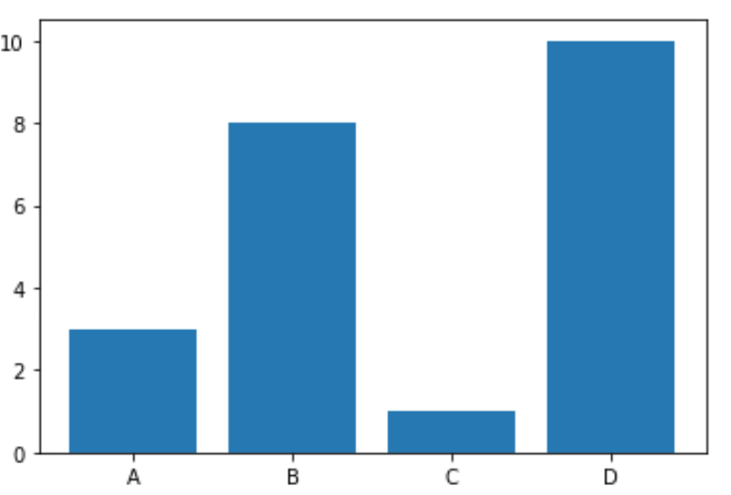
bar() Plot with Matplotlib
Let's see the following example with bar():
Ex: import matplotlib.pyplot as plt import numpy as np x = np.array(["A", "B", "C", "D"]) y = np.array([3, 8, 1, 10]) plt.bar(x,y) plt.show() >>>

Slide 10
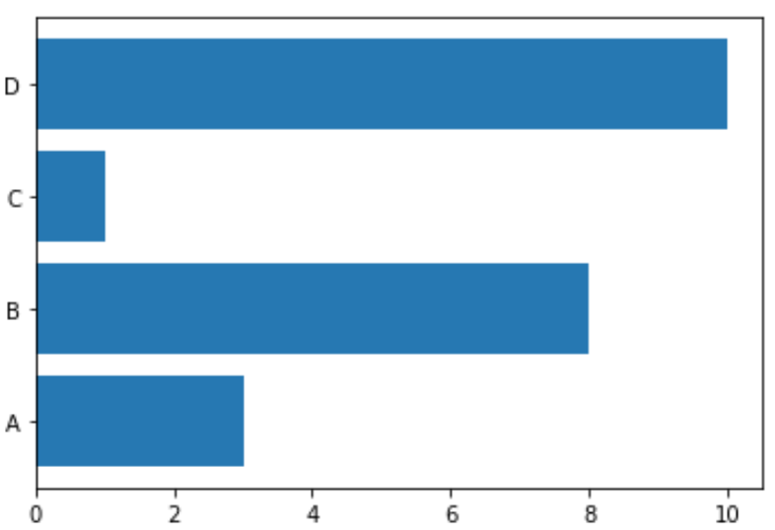
barh() Plot with Matplotlib
Let's see the following example with bar():
Ex: import matplotlib.pyplot as plt import numpy as np x = np.array(["A", "B", "C", "D"]) y = np.array([3, 8, 1, 10]) plt.barh(x,y) plt.show() >>>

Slide 11
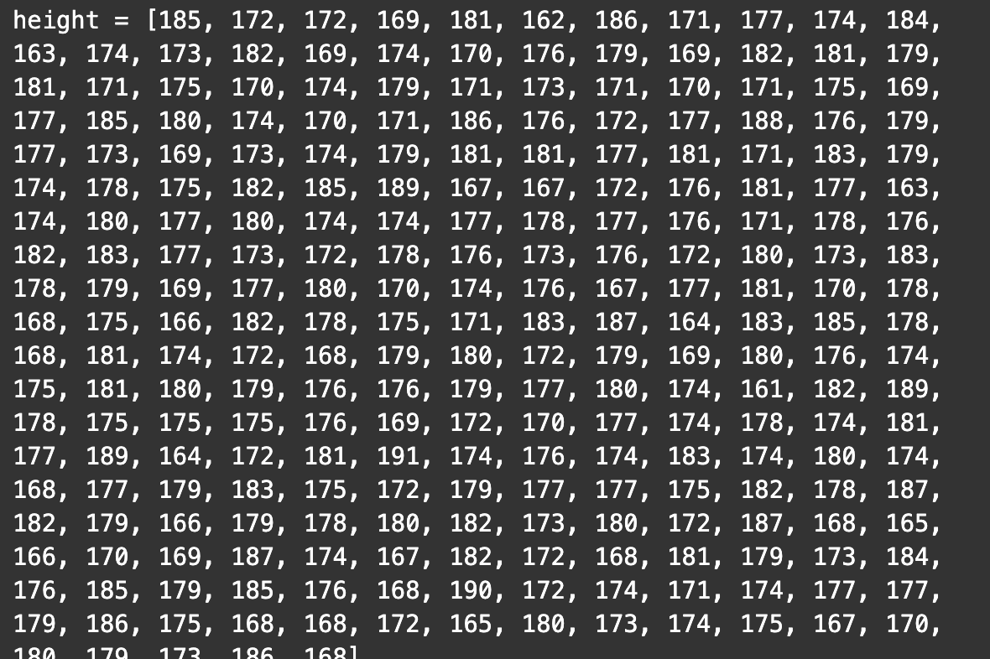
Histogram
A histogram shows the number of occurrences of different values in a dataset. At first glance, it is very similar to a bar chart. Histogram is more like a bar chart. Let’s consider an example and we will see immediately why.
Let’s say that we run a gym and we have 250 clients. For some reason,we want to analyze their heights. We have the individual data points – the height of each and every client in one big Python list:

Slide 12
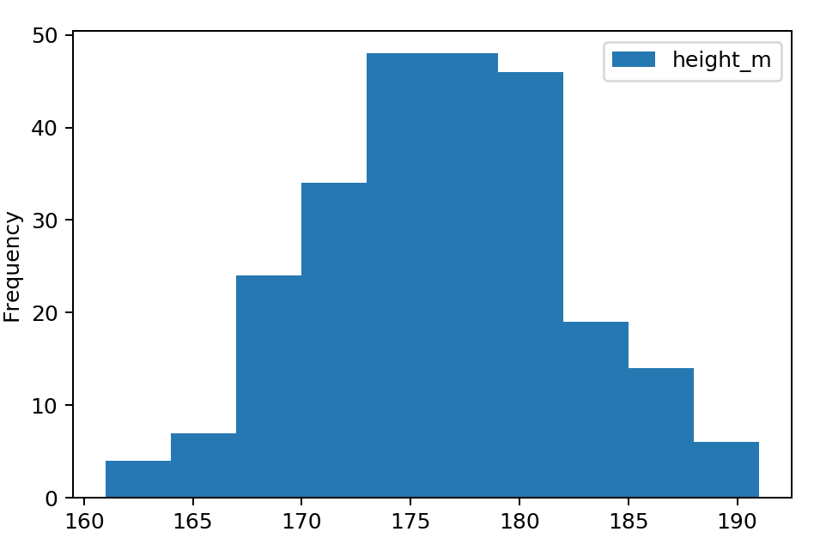
Histogram : chart
For that dataset, the histogram will look like the following. In the y axis, it’s showing the frequency of weight.
From here, we can guess the mean of the weight is around 175 and the mode is around 174. This one of the advantages of creating a histogram on dataset.

Slide 13
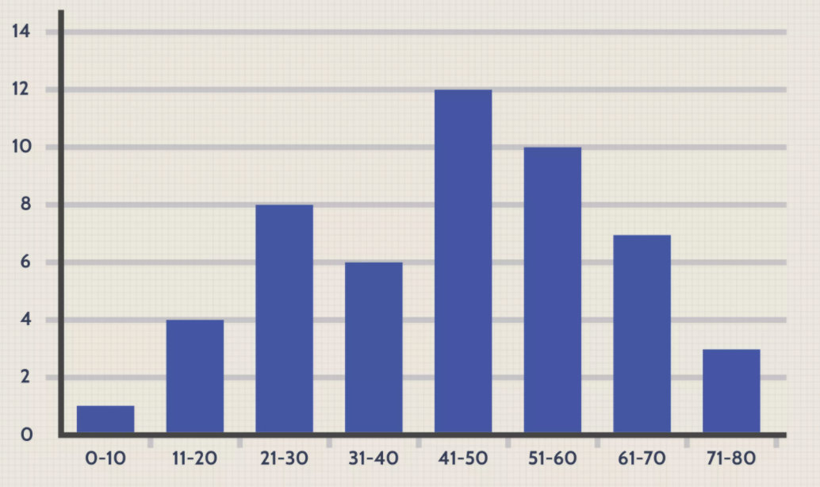
Histogram : another example
Another example can be given with a census focused on the demography of a country. We may use a histogram to show how many people are between the ages of 0 - 10, 11 - 20, 21 - 30, 31 - 40, 41 - 50, etc. This histogram would look similar to the example below. In y axis, the following graph is also showing the frequency of ages that appear in the range.

Slide 14
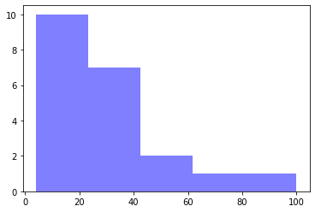
Histogram with Matplotlib
In Matplotlib, we use the hist() function to create histograms. The hist() function will use an array of numbers to create a histogram, the array is sent into the function as an argument. Say you ask for the height of 250 people, we might end up with a histogram like this:
Ex: import matplotlib.pyplot as plt import numpy as np xx = [21,22,23,4,5,6,77,8,9,10,31,32,33,34,35,36,37,18,49,50,100]
num_bins = 5
n, bins, patches = plt.hist(x, num_bins, facecolor='blue', alpha=0.5)
plt.show()
>>>

Slide 15
Pie chart
A pie chart is a circular statistical graphic, which is divided into slices to illustrate numerical proportion. It expresses a part-to-whole relationship in your data.

Slide 16
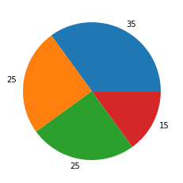
Pie chart with Matplotlib
With Pyplot, we can use the pie() function to draw pie charts:
Ex: y = np.array([35, 25, 25, 15])
plt.pie(y)
plt.show()
>>>

Slide 17
What is Boxplot
A boxplot is a standardized way of displaying the distribution of data based on a five number summary (“minimum”, first quartile (Q1), median, third quartile (Q3), and “maximum”)

Slide 18
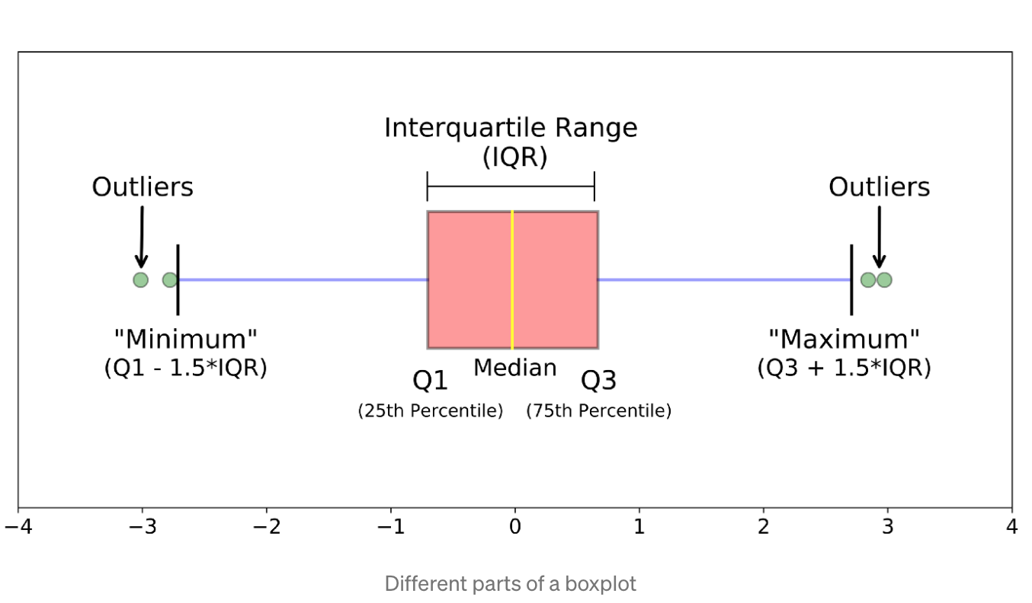
Boxplot

